Slide 1

Supermarket shopping application
Dr. Shafqat Ali Shad
Duy Thanh Vo – 986033
Huynh Huong Duong Truong - 986043

Slide 2
Content
Wholeness
Use Cases
Technologies
Architecture
Diagrams
Demo

Slide 3
Wholeness
Supermarket Shopping Application (SSA) will enable customers to buy products, as well as proceed checkout their shopping card toward make payment for their order. Also, they can track their order history if they have registered an user account in application. Moreover, they can update their profile, as well as update the payment information which includes credit/debit card information and shipping address.
When a customer first open SSA, he/she views products from home screen. Products are organized follow category list. He/she adds products to their shopping cart and continue shopping or they proceed checking out. Also, SSA will verify the product from stock whether these products are available.
For customers who have logged in to application which the shipping information and payment information supplied, he/she has more “Buy 1-Click” feature on a specified product. Also, they can enable or disable this feature from their settings.
Once the customer has completed choosing products, customers can proceed checking out their shopping cart. The SSA also will look up the promotion information whether there are any discounts applying to products in this shopping cart. After that, customer can go to payment screen to complete their order by supplying the bank card information, as well as the shipping information.
Especially, customer will belong to different types Standard, Silver and Gold. When customer first register to the SSA, their type are Standard. They can be promoted to another type depend on total amount of their order values in the history. He/she also will receive a discount percentage on next their orders in future.

Slide 4
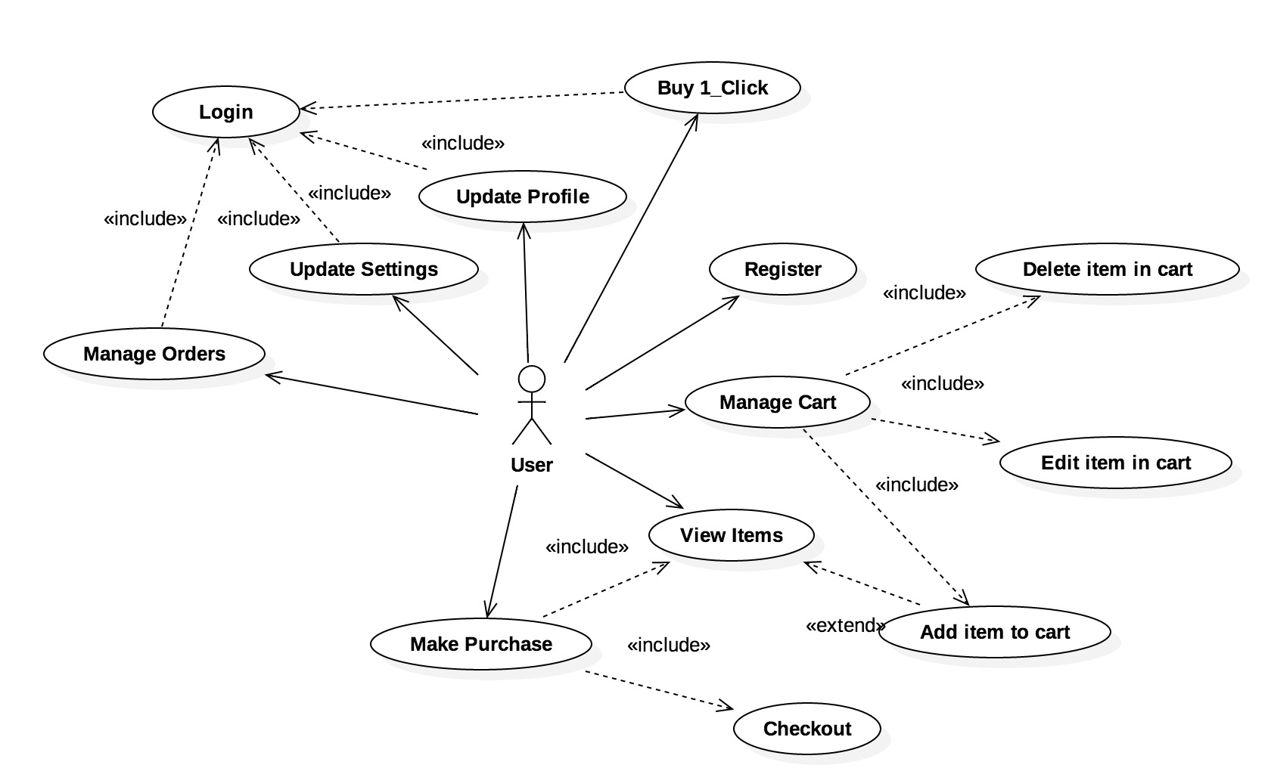
Use cases

Slide 5
technologies
Front-End: JavaFX
Back-End: Java
Database: SQLite

Slide 6
architecture
Presentation Layer: JavaFX
Business Logic Layer (BUS)
Domain Object
Data Access Layer (DAO)
Data Object (DO)
DB Connection
SQLite

Slide 7
Diagrams
Class Diagrams: Domain, BUS and DAO
Sequence Diagrams

Slide 8
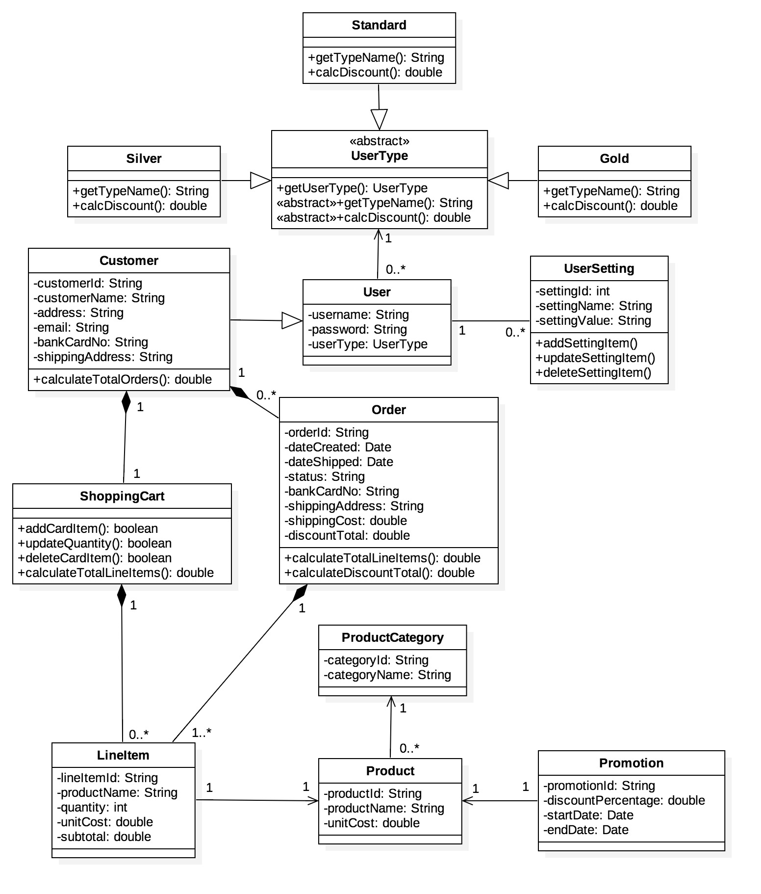
Domain

Slide 9
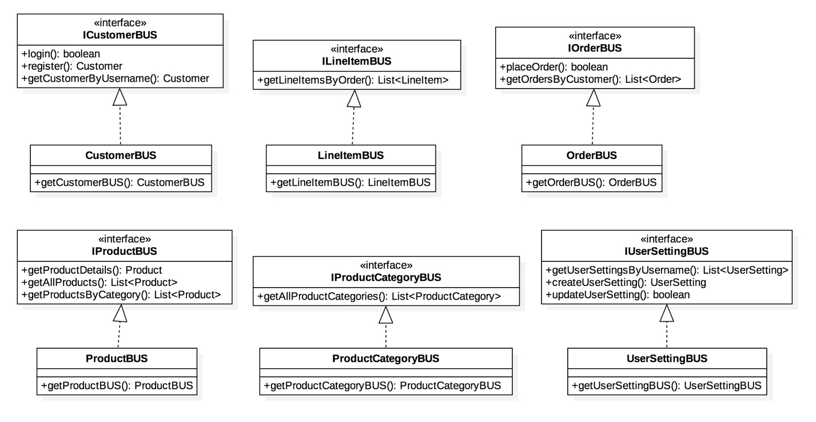
Business Logic Layer (BUS)

Slide 10
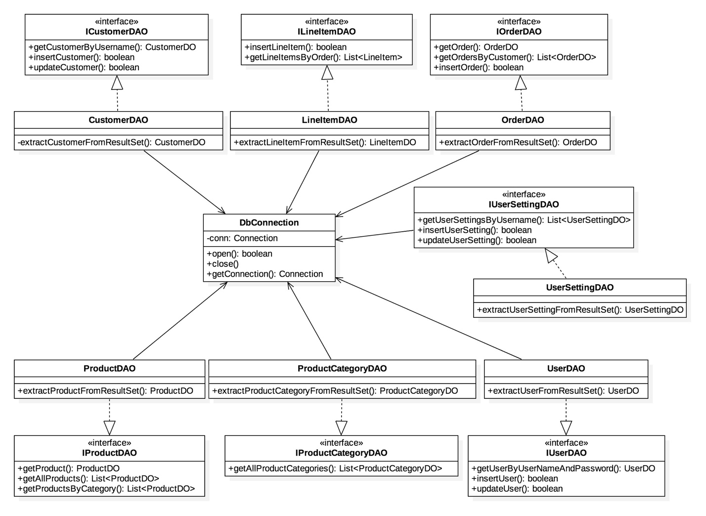
Data Access Layer (DAO)

Slide 11
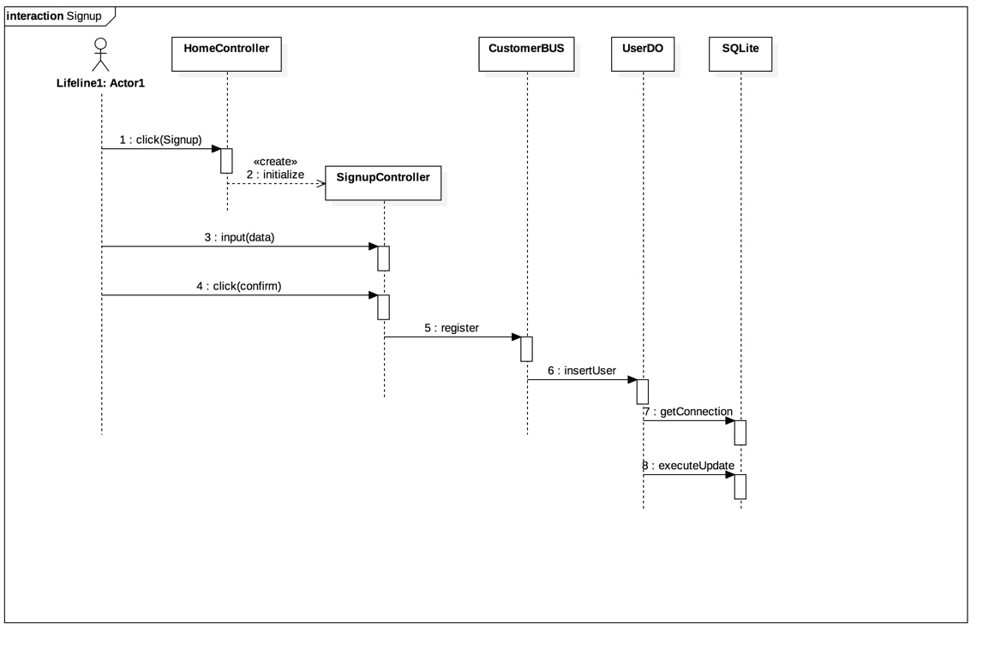
Sequence - Sign Up

Slide 12
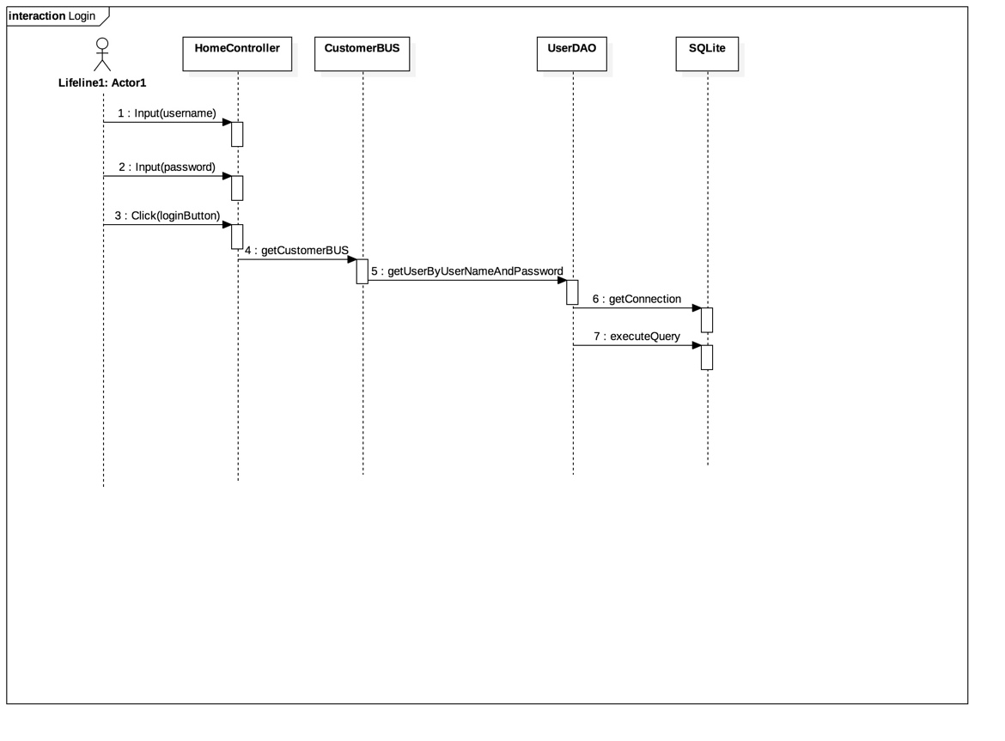
Sequence – login

Slide 13
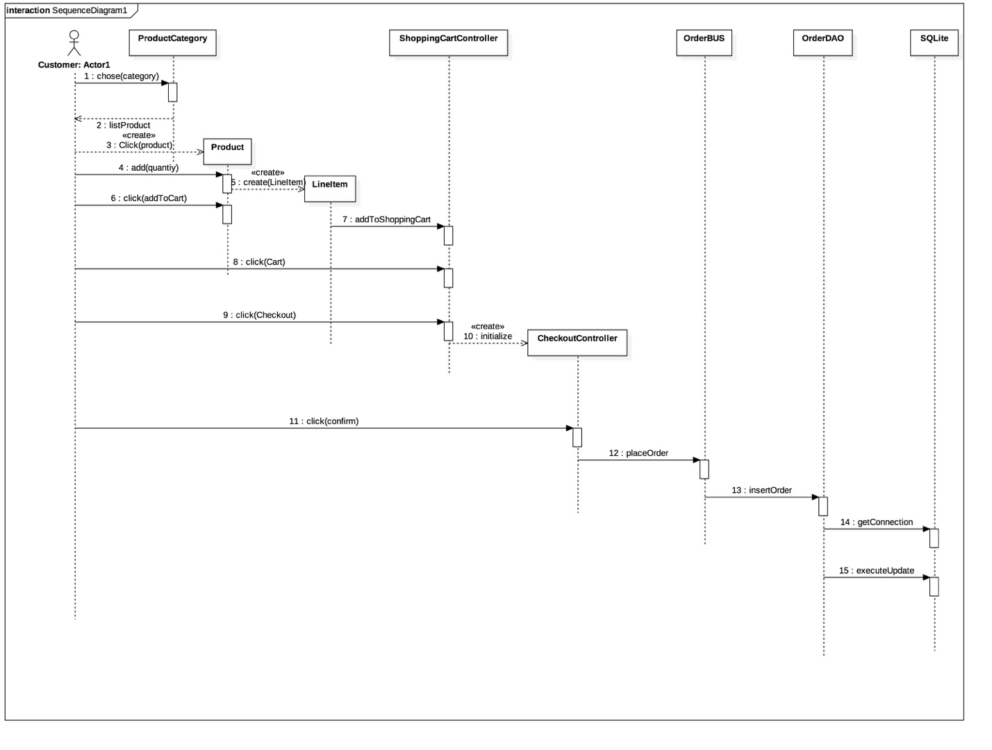
Sequence - Add Shopping Cart

Slide 14
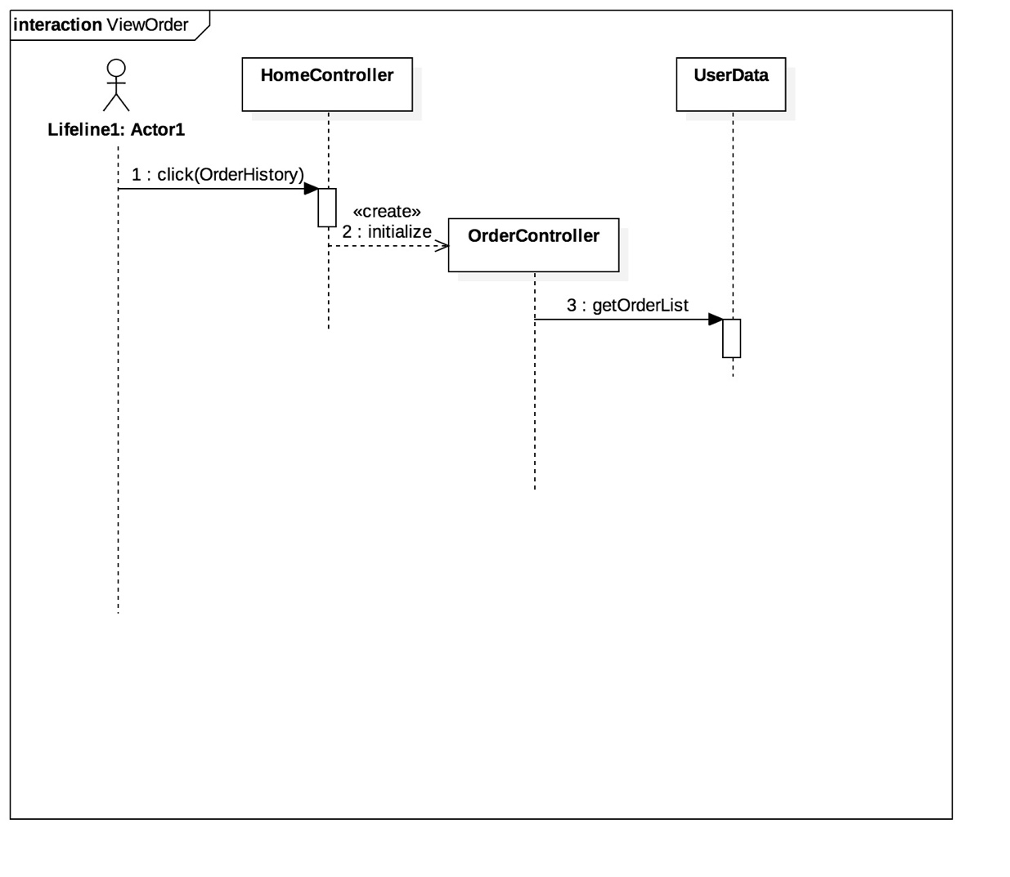
Sequence - View Order

Slide 15
demo
Sign up
Login
Choose Product
Manage Shopping Cart
Check Out
Buy 1-Click
Update Profile
View Order History

